Slide 1

Introduction to git, jenkins and vm

Slide 2
GIT

Slide 3
installation (Windows)
Installation of Git is quick and simple.
Click on the link below
https://github.com/git-for-windows/git/releases/download/v2.5.1.windows.1/Git-2.5.1-64-bit.exe
Launch the exe file, and follow the installation steps.

Slide 4
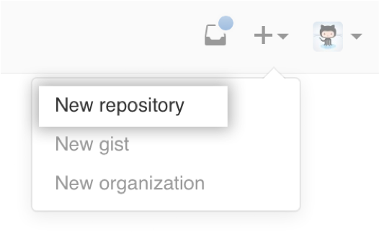
creating a repository
To create a repository you’ll first need a GitHub account.
Then you click the + icon next to your profile picture and select ‘New repository’
You then give your repository a name and set it to public or private.
You can then clone the repository to your local machine

Slide 5
configuration
You will need to configure your Git username on your local machine.
This is to ensure your commits are tracked properly by GitHub
To do this use git config –global user.name “USER”

Slide 6
basic commands
ls – shows you the directory you are currently working in
cd filename – allows you to navigate to the selected file name
cd .. – allows you to navigate the directory above where you currently are
cd – allows you to go to root

Slide 7
Basic Commands
git status – Allows you to see the stage at what your repository is like compared to the shared repository.
git pull – pulls the shared repository from GitHub and updates your local repository.
git commit –m “insert message here” – this command snapshots the changes you want to make

Slide 8
Basic Commands
git add filename – stages the file ready for commit
git push – pushes the snapshots you have taken to the shared repository
git reset <filename> - this will undo the addition of a file in git add
WARNING – PUSHING CAN CAUSE CONFLICTS

Slide 9

Git Keywords
Index - the index is essentially a staging area between your working directory and the repository, when you add a file with git add, it goes to the index. Running git status will show you what is and isn’t currently in the index.
Head - the head is basically where you are within the project, it tells you what branch you’re on. The head can be ahead or behind the repository and using git checkout you change the head onto another branch and/or a previous commit

Slide 10
ignoring files
Sometimes there are files that we don’t want to push into the repository because they are local to a machine and won’t work on another one
To do this we use a text file called .gitignore which will tell Git to not track any changes to it
For example: /.classpath
Sometimes the .gitignore file won’t be created automatically, how you create one depends on your OS

Slide 11
Ignoring Files
Windows: create a new text file in your project directory called .gitignore. – this will be abbreviated by Windows into a new .gitignore file, you can then edit it using a text editor of your choice
On Mac you can simply use “touch .gitignore” inside your project to create it and “nano .gitignore” to edit it

Slide 12
moving files
In order to move a file, you need to know two things, firstly where the file is stored, and secondly where it will be moved to.
Example:
git mv filename/ filelocation/
Bare in mind that locations need to be from the current position.

Slide 13
merge conflicts
When more than one person has altered the same piece of code and push their respective work. Git won’t know which one to use, causing a merge conflict.
When a merge conflict happens, errors will appear in your code as Git will put all the conflicting pieces of code one after another and leave it to you to sort things out.
You need to decide which piece/s of code to use and delete the others, then commit and push to fix the conflict. When you push your changes, Git merges your new additions with the repository, overwriting the old code with the new.

Slide 14
Standard merge conflict
<!-- Author: Alexander Shvets (alex@githowto.com) -->
<html>
<head>
<<<<<<< HEAD
<link type="text/css" rel="stylesheet" media="all" href="style.css" />
=======
<!-- no style -->
>>>>>>> master
</head>
<body>
<h1>Hello,World! Life is great!</h1>
</body>
</html>

Slide 15
branching
Branching means you diverge from the main line of development and continue to do work without messing with that main line.
A branch in Git is simply a lightweight movable pointer to one of a commit. The default branch name in Git is master. As you start making commits, you’re given a master branch that points to the last commit you made. Every time you commit, it moves forward automatically.

Slide 16
Branching
A branch in Git is simply a pointer to a commit. The default branch name in Git is master. As you start making commits, you’re given a master branch that points to the last commit you made. Every time you commit, it moves forward automatically.
Running the command: git branch [name] will create a new pointer of the name specified.
This will also change the HEAD (a pointer to let Git know which branch you are on). Any commits made to this branch are entirely separate from the other one/s.

Slide 17
branch commands
git checkout –b [branch name] – create a branch
origin [branch name] – use this during pushing and pulling to specify which branch you are referring to
git branch –d [branch name] – delete a branch
git merge [branch 1]/[branch 2] – merge two branches together

Slide 18
reversing changes
If you want to revert your local workspace to the last commit (if something has gone wrong for example) you can do so with these commands:
git clean –df (Removes all unstaged files)
git checkout -- . (Clears all unstaged changes)

Slide 19
rules of git
Write useful commit messages
Always pull before you push – it won’t let you anyway
Re – cloning is not a way of fixing merge conflicts
Do not commit broken code – test beforehand

Slide 20
Rules of Git
Commit often, push once
If you have two pieces of separate functionality, that should be split into two commits
Do not merge or delete unmerged branches without everyone else’s consent
Do not push files that are different for each user for example the .classpath file

Slide 21
Git Workflows
Centralised: Utilises a single master branch, with each developer pushing and pulling from it.
Feature Branch: Each feature is a separate branch, which, when completed is merged with the master to create a release build.

Slide 22
Git Workflows
Gitflow: The master has only the release builds in it, with a development branch alongside to integrate the individual feature branches into a release that is then pushed to master. Additionally, maintenance branches are forked off master to fix bugs and issues with release builds and merged with the master and develop branches

Slide 23
Git Workflows
Forking: Every developer has their own private repository that is forked from the main project repository. Only they can push to it however they may pull from any other developer’s repository. In this model, a project manager has sole authority to push to the main project repository. Once a developer has a commit, they file a request with the manager to have it pushed to the main repository.

Slide 24
JENKINS

Slide 25
git and jenkins
First off you need the Git plugin from the Jenkins plugin manager
Once that is successfully installed you will see an additional option when you create a new job under “Source Code Management” called Git

Slide 26
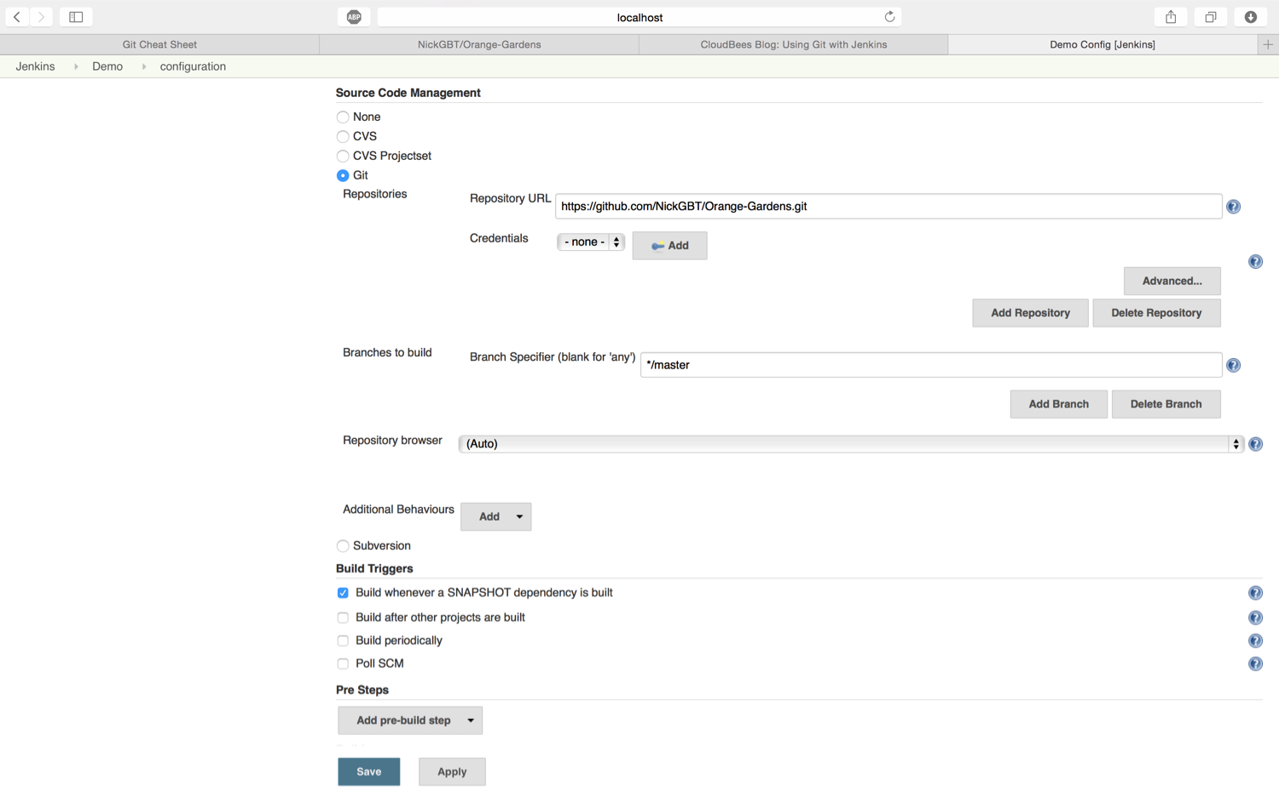
Git and jenkins

Slide 27
advanced configuration
There are a number of options that can be configured on the build. For example, you can set your Git username and email so that the repository on GitHub will track your commits properly.
This plugin can be used to implement a pre-commit feature wherein commits are merged into a stable branch only if builds happen successfully on a development branch.

Slide 28
Live Demo

Slide 29
VIRTUAL BOX

Slide 30
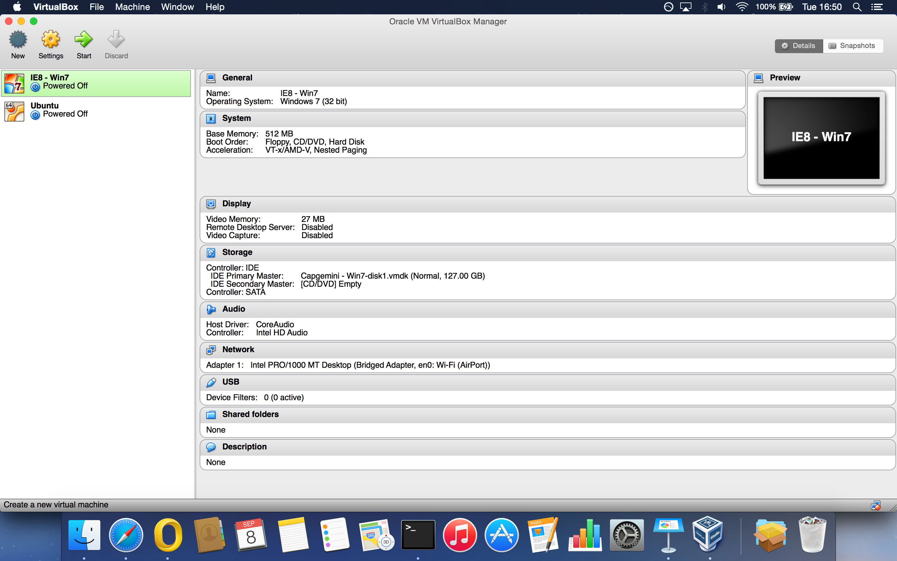

Slide 31
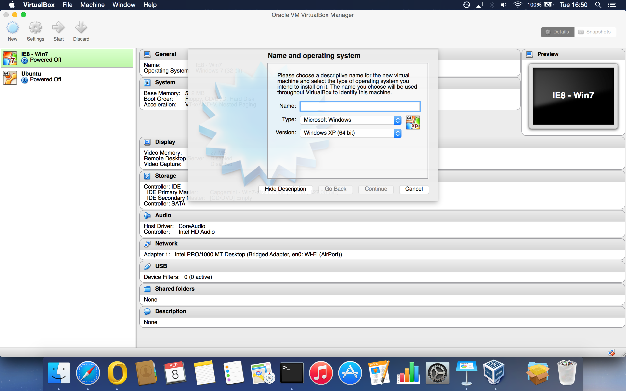

Slide 32
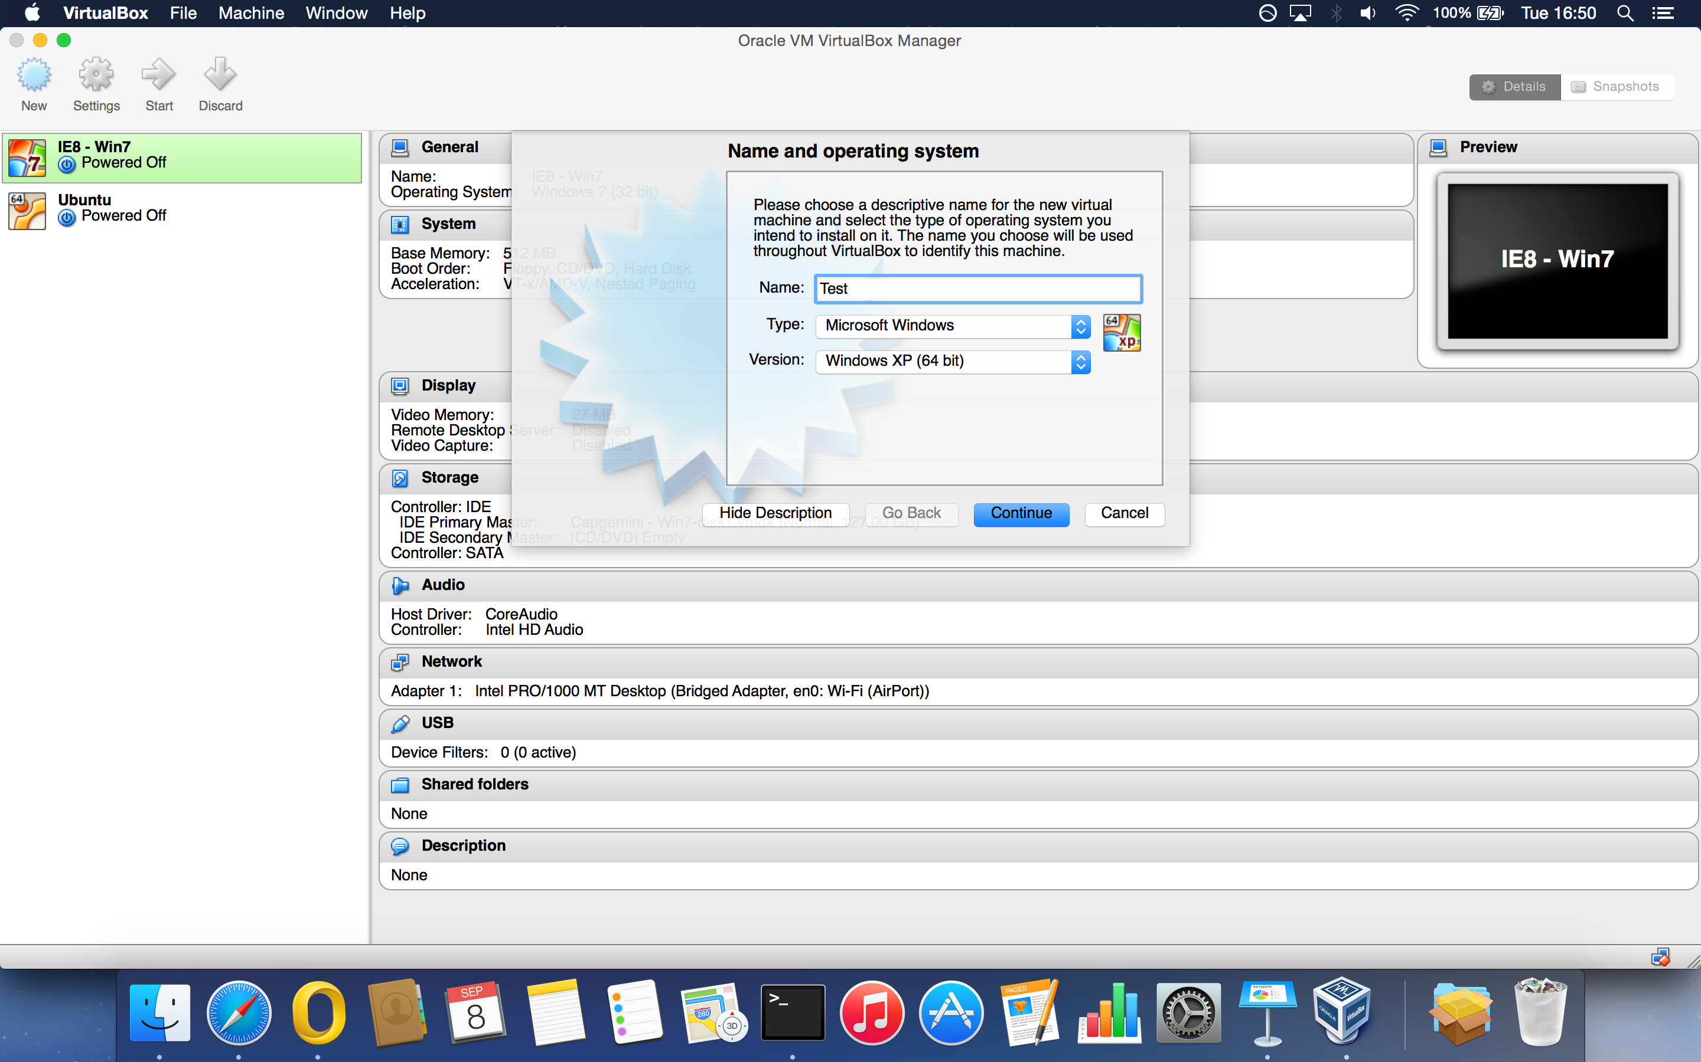

Slide 33
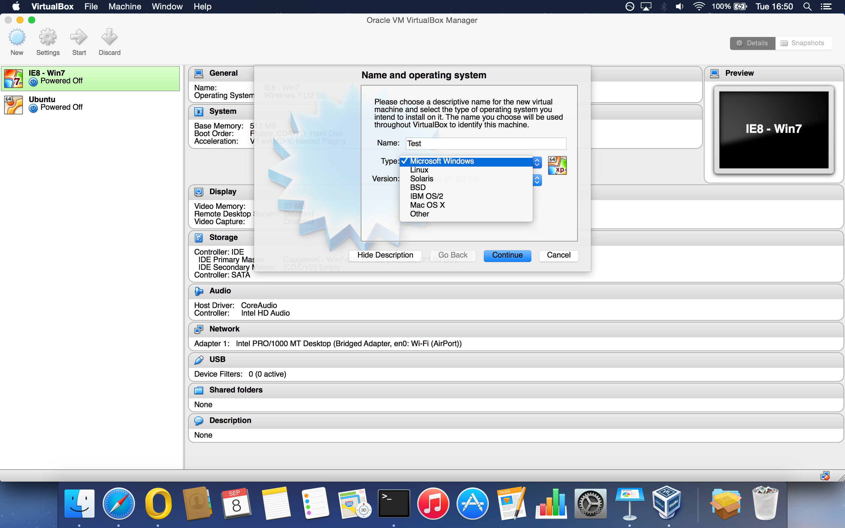

Slide 34
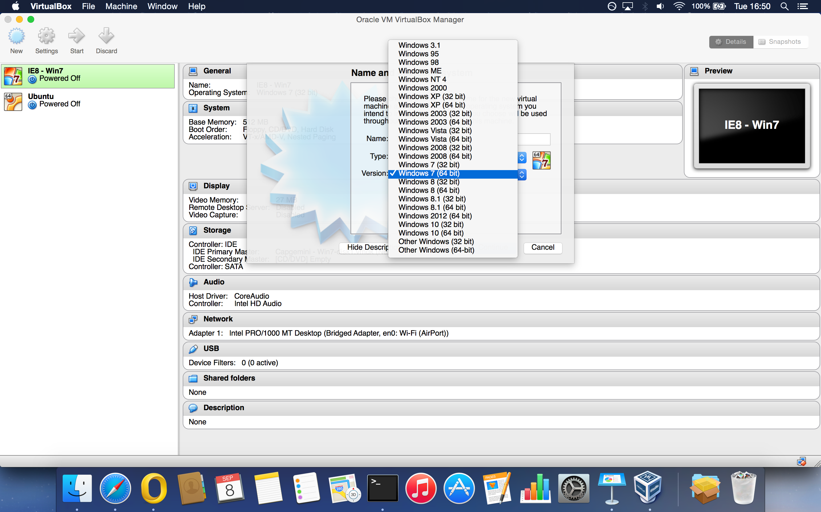

Slide 35
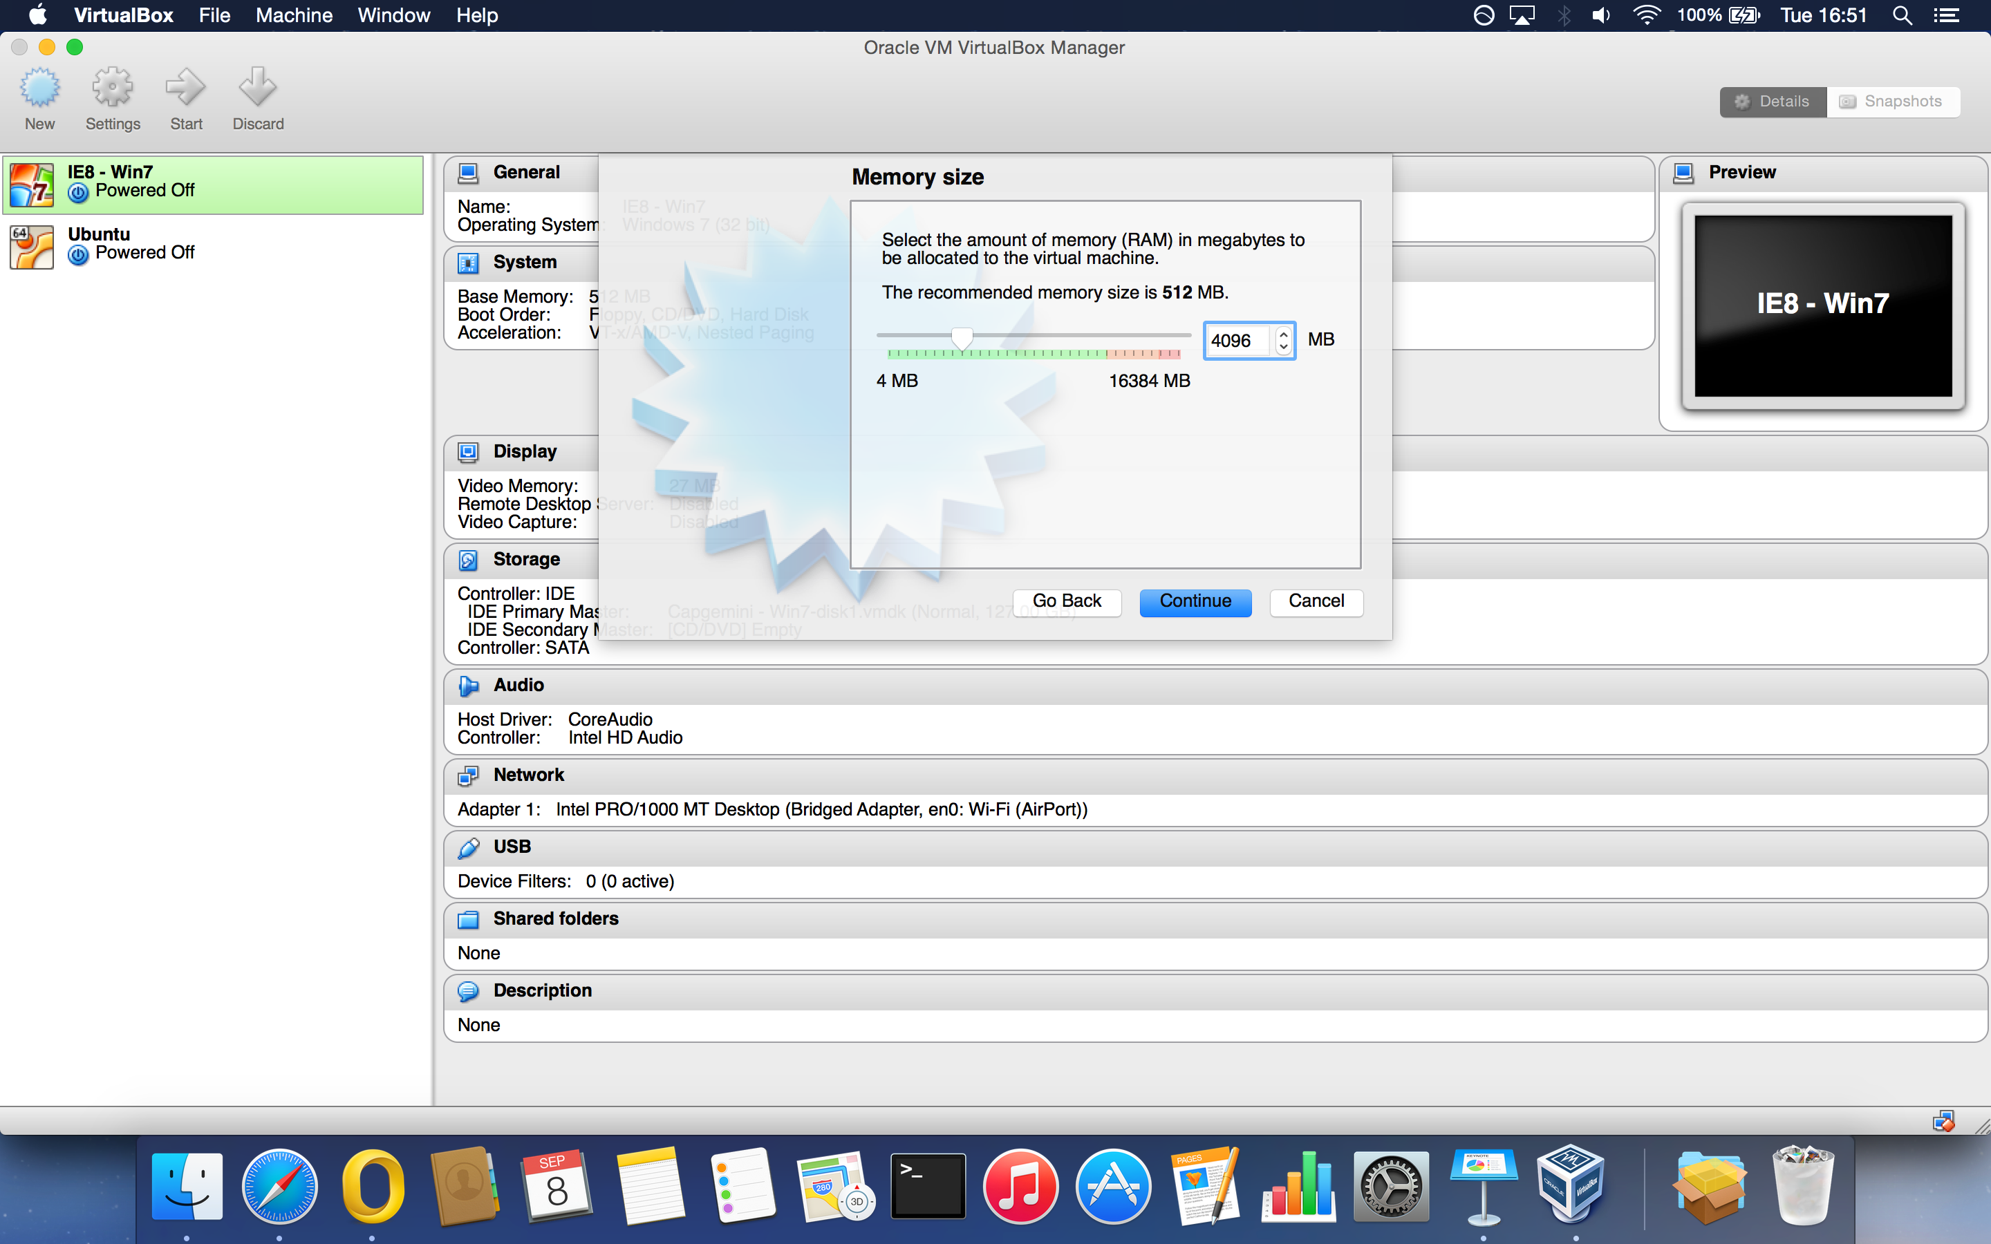

Slide 36
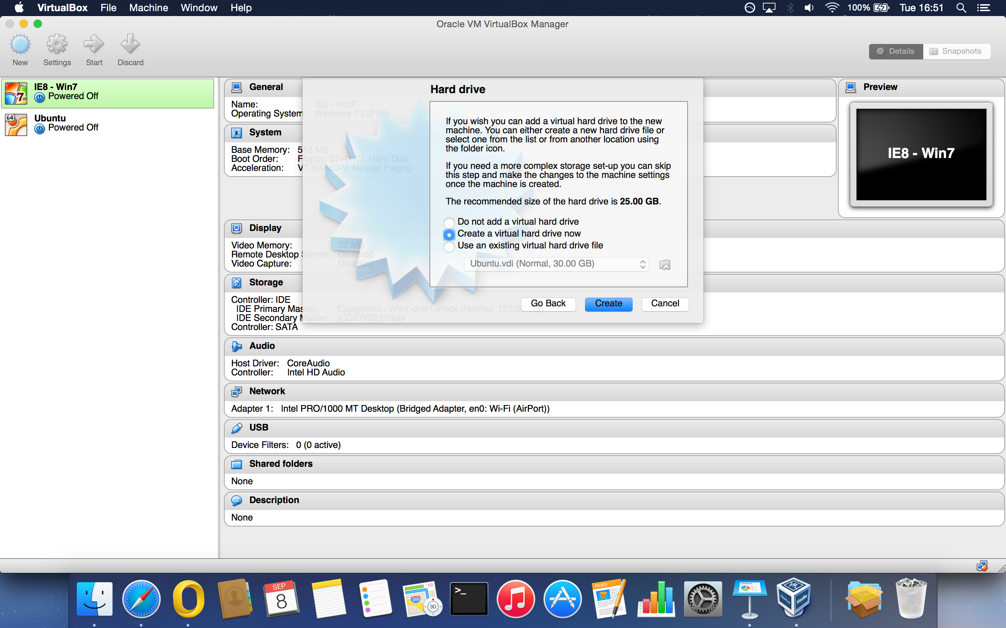

Slide 37
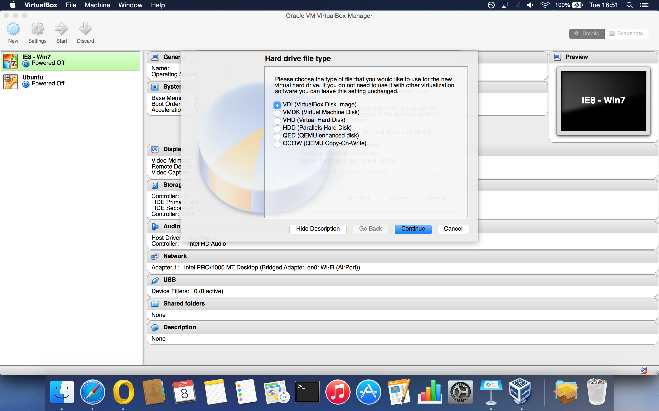

Slide 38
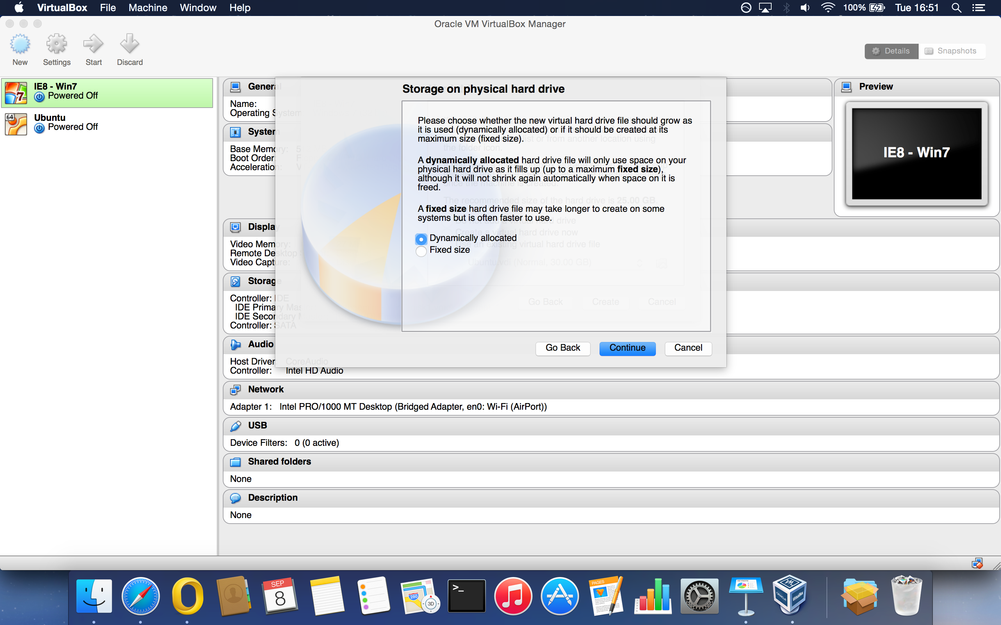

Slide 39
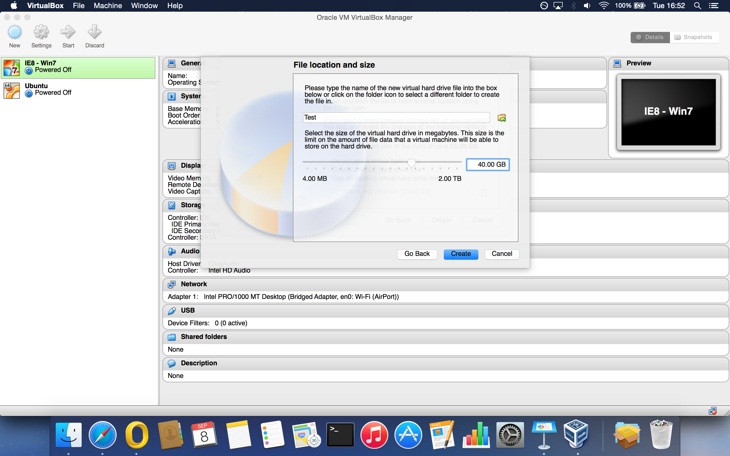

Slide 40
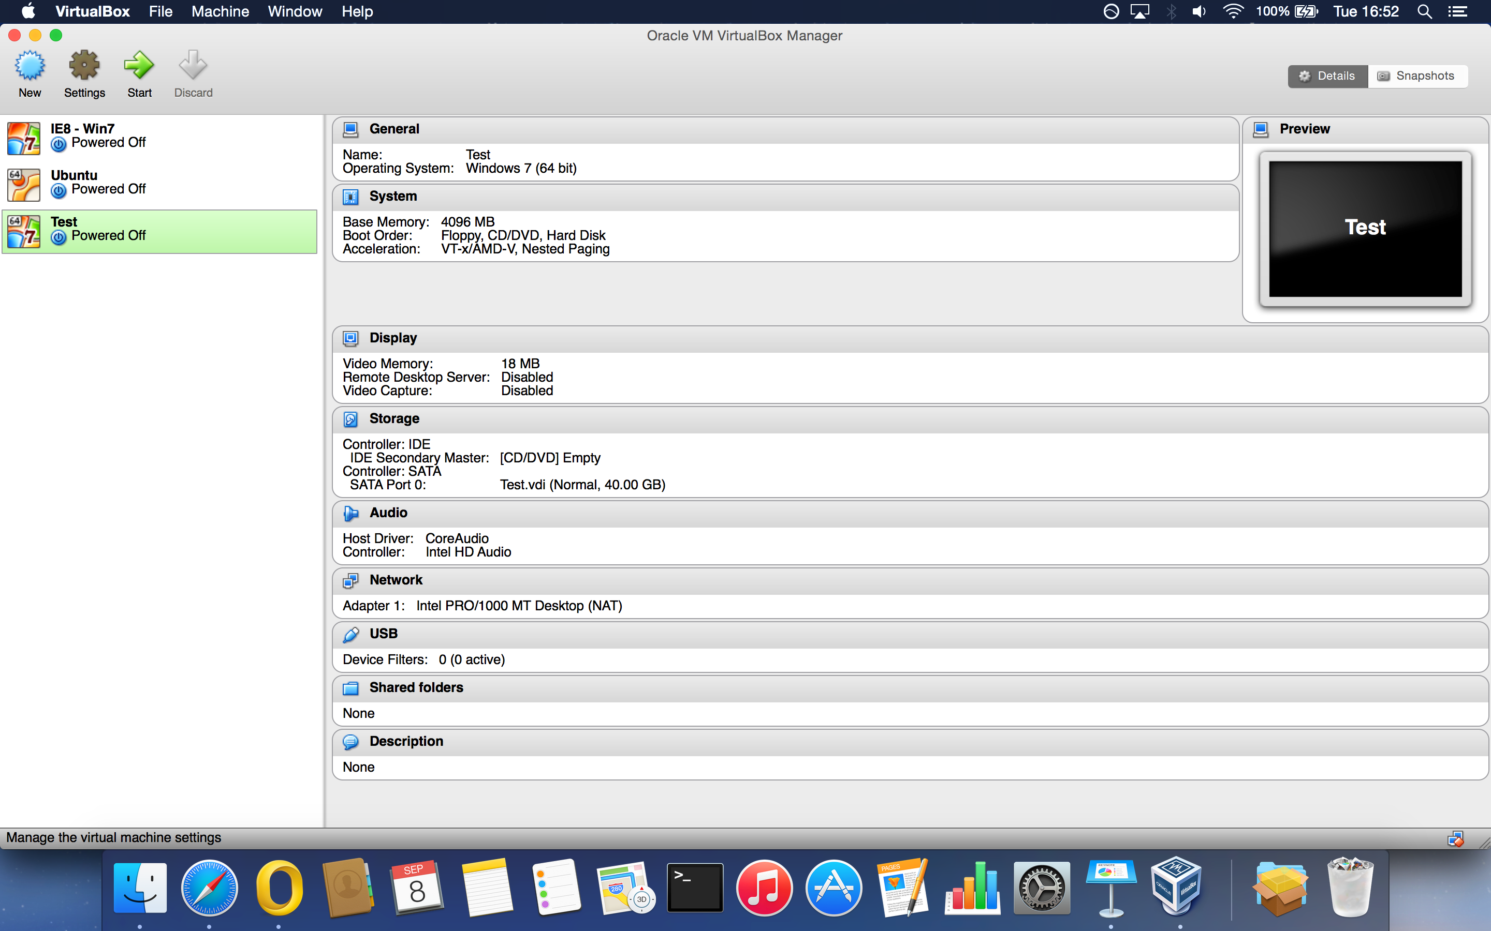

Slide 41
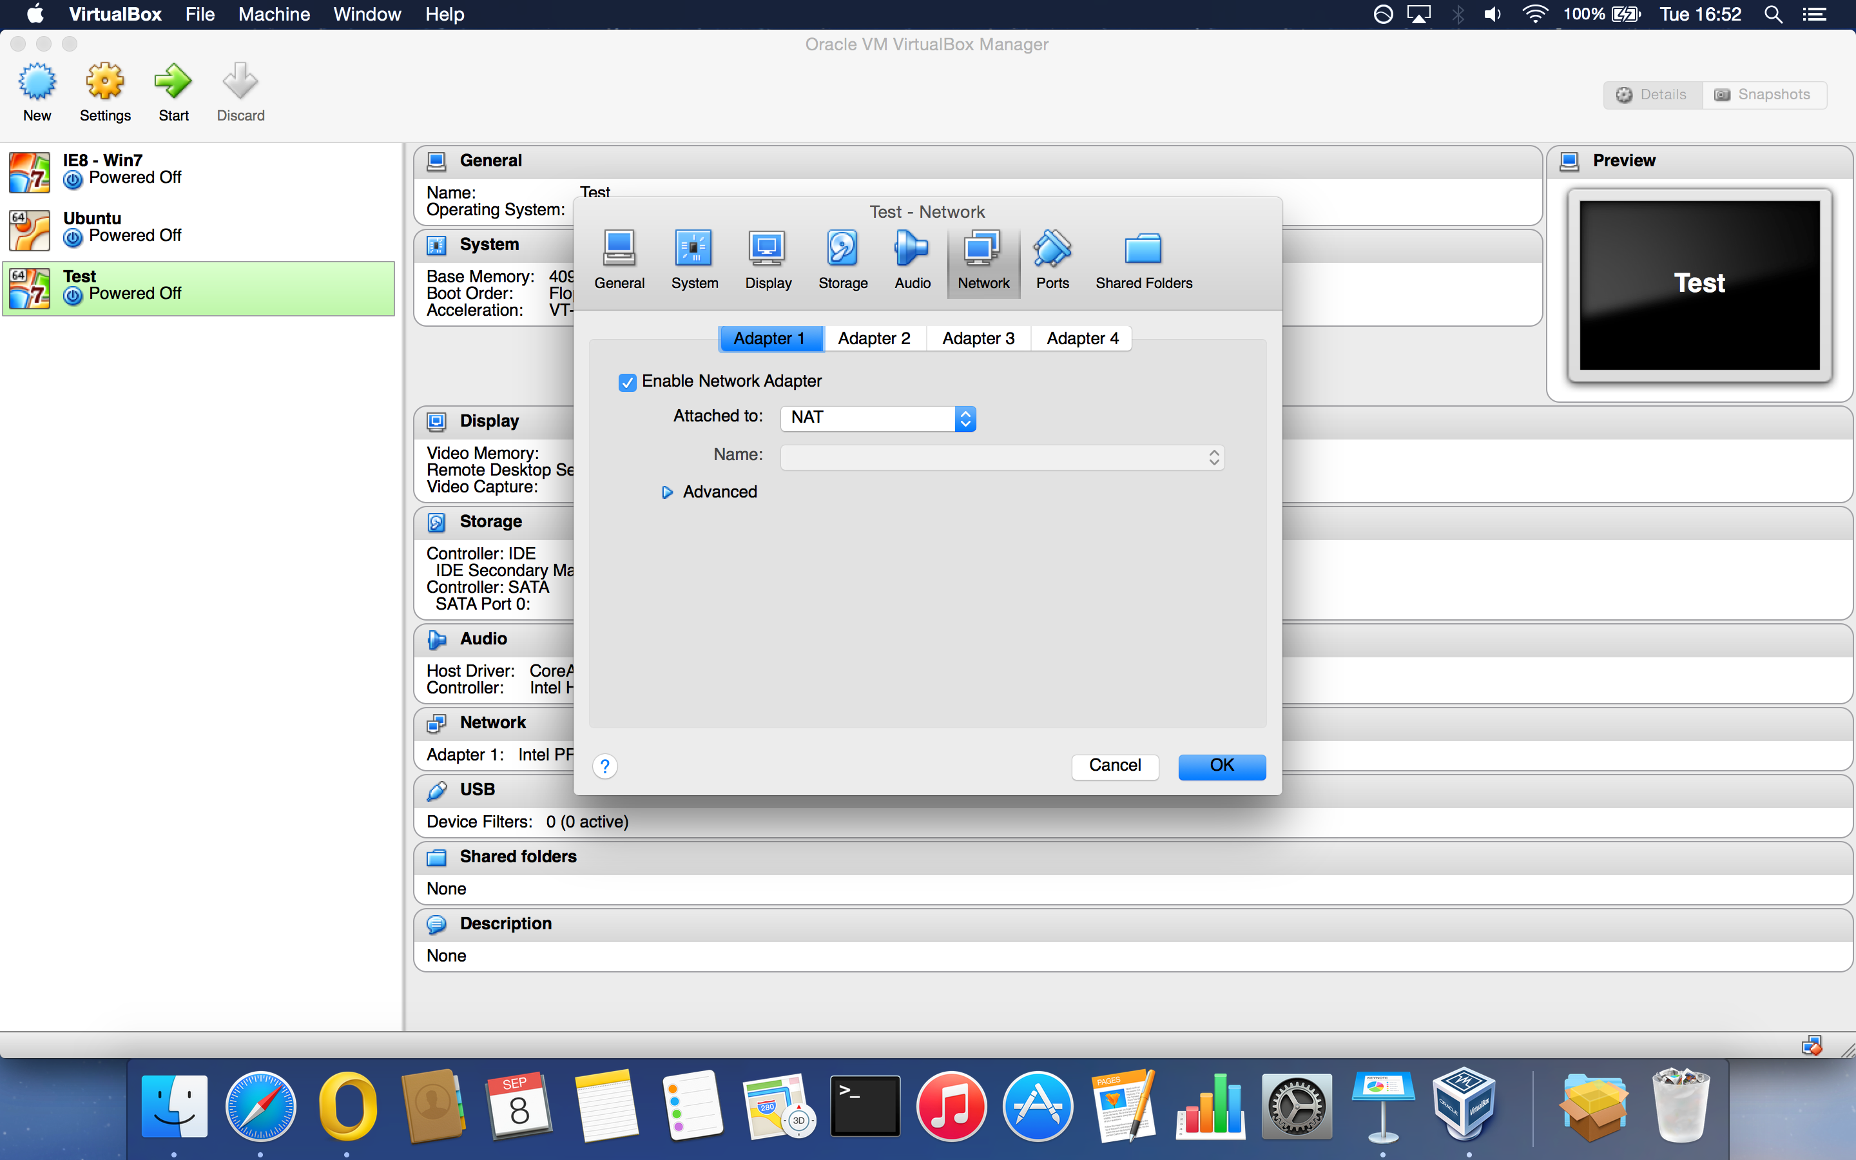

Slide 42
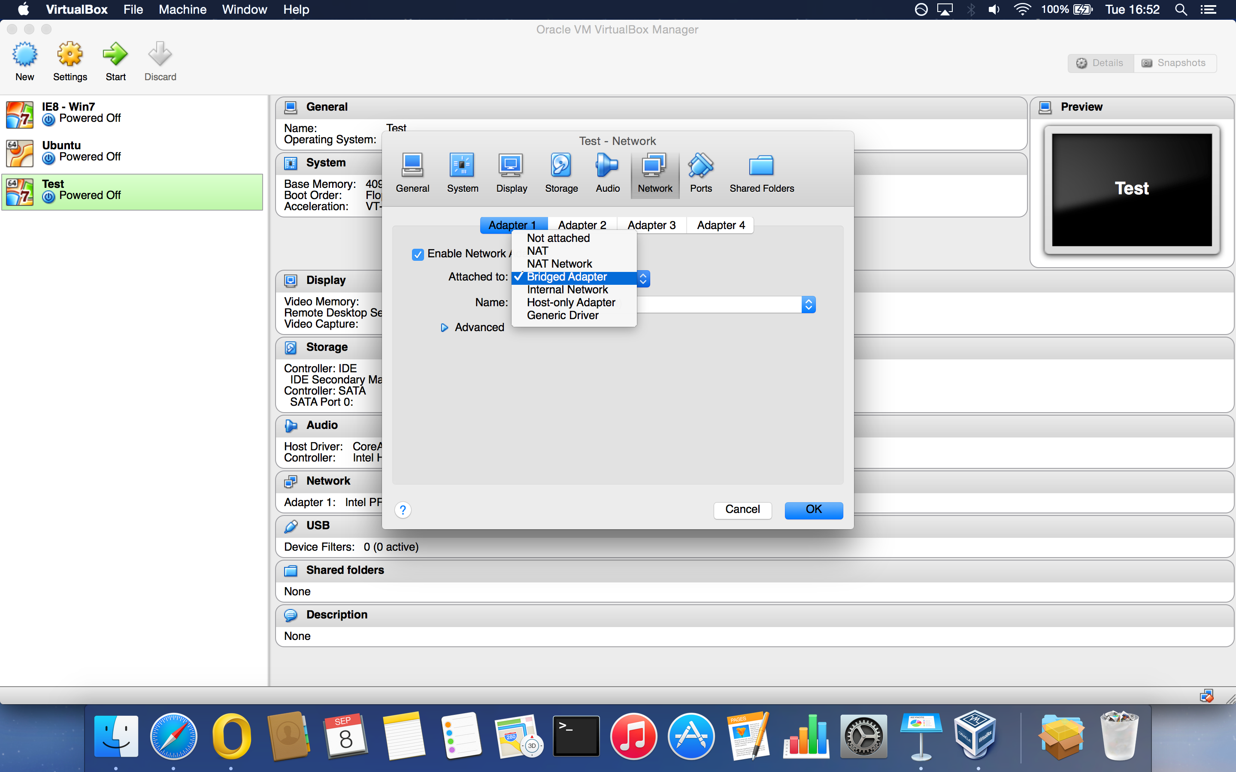

Slide 43
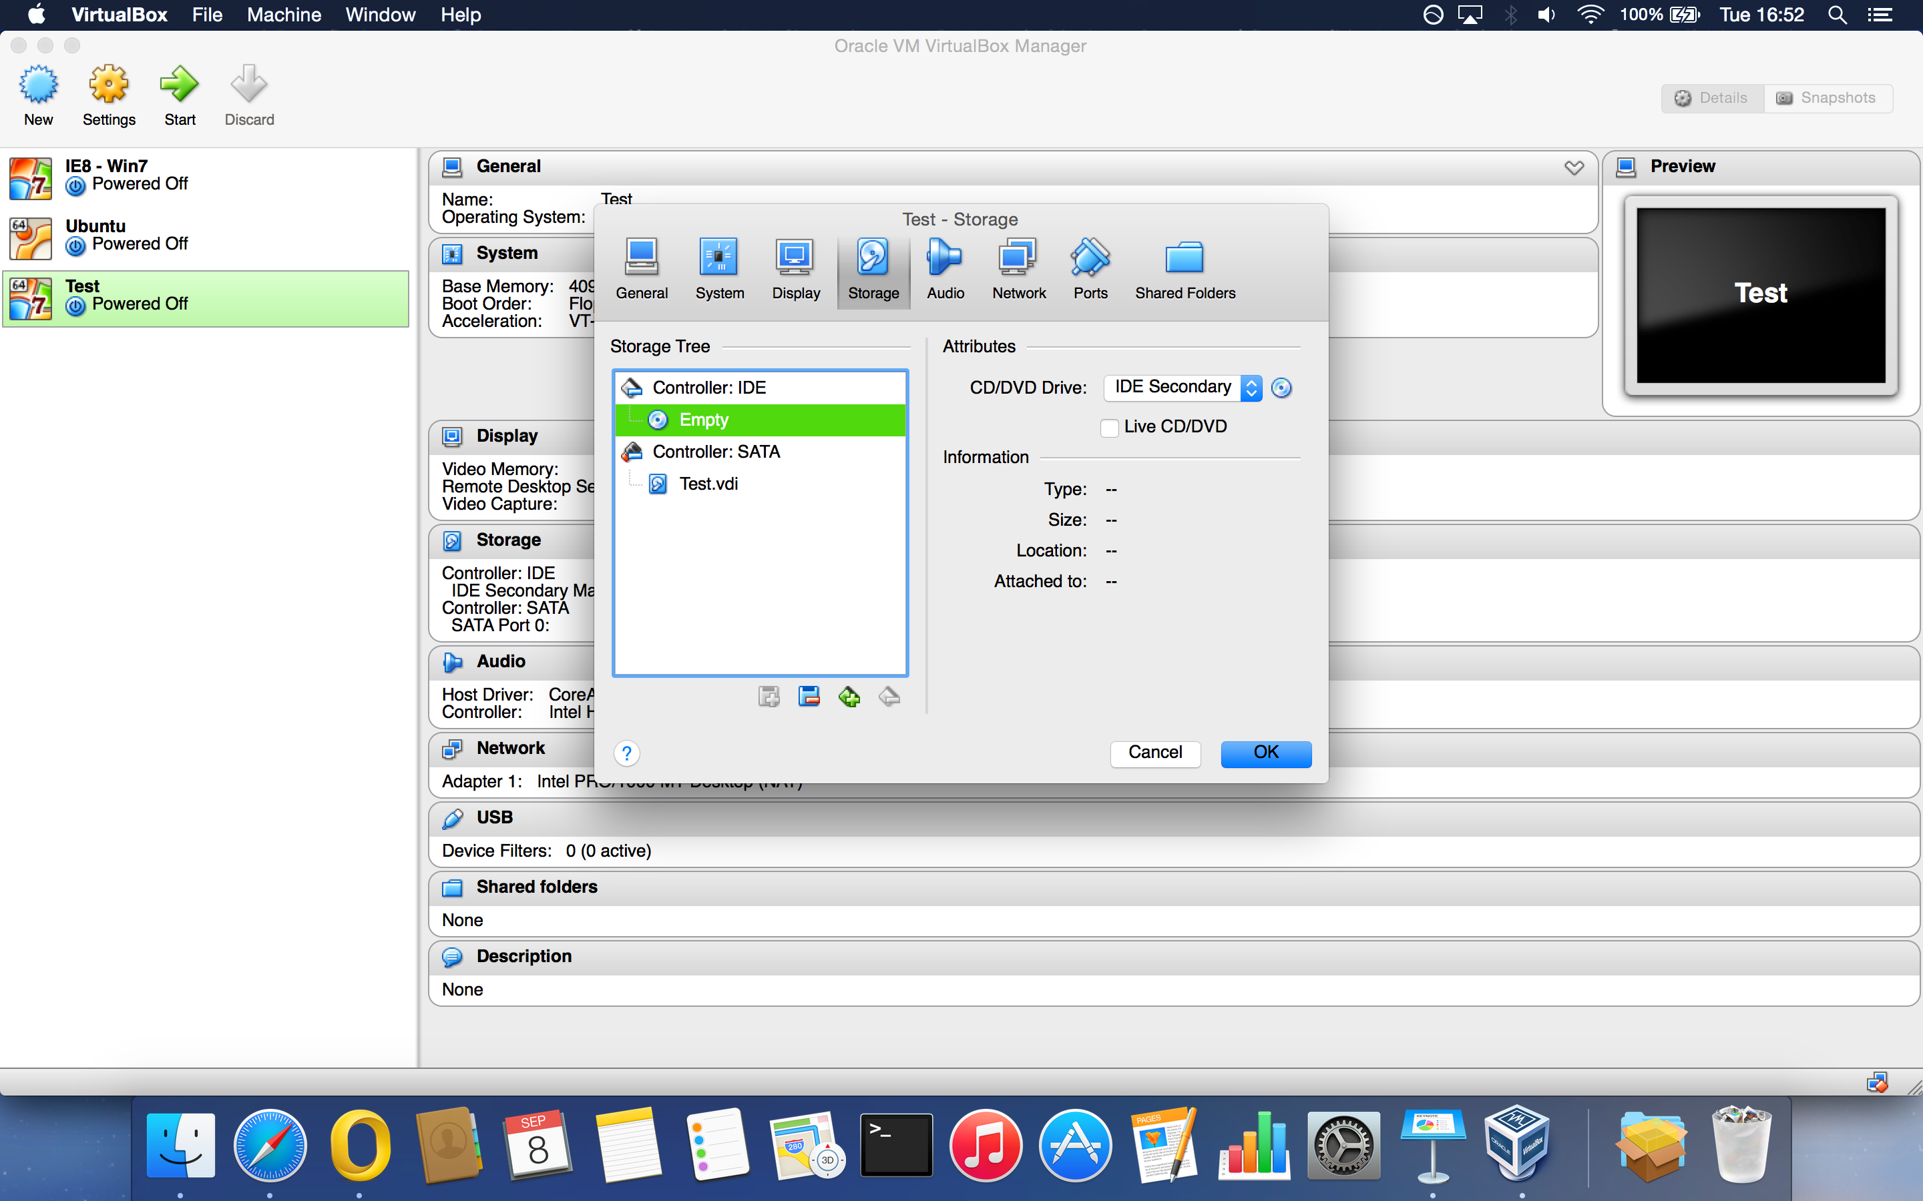

Slide 44
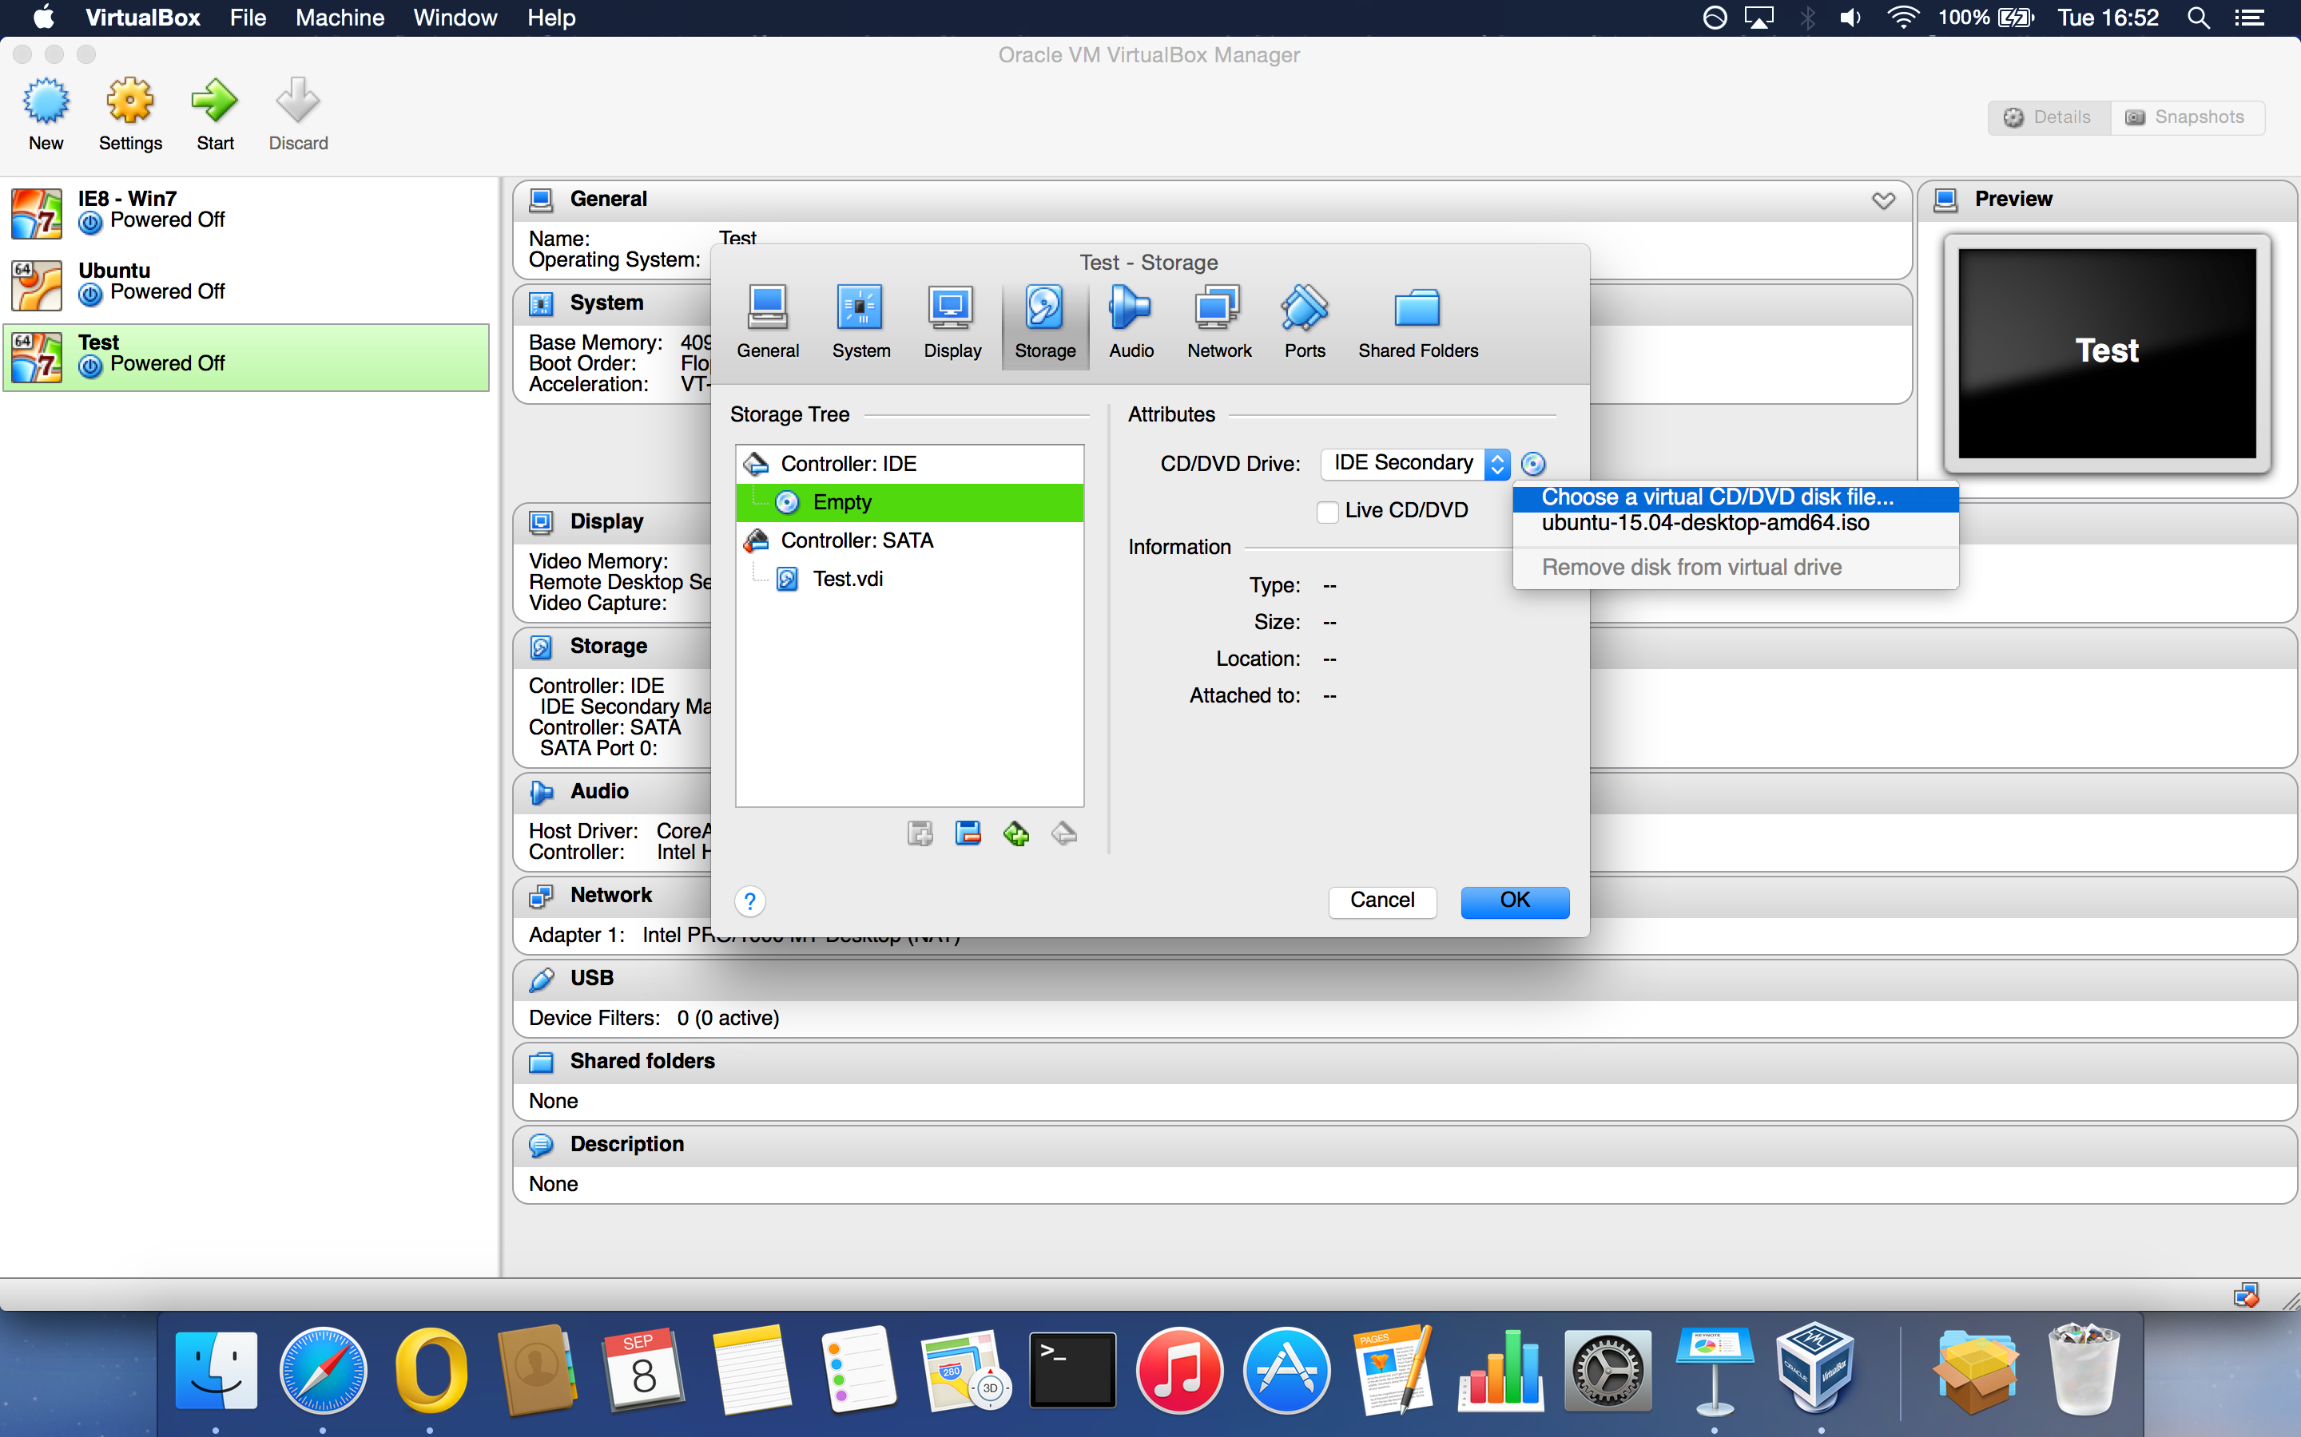

Slide 45
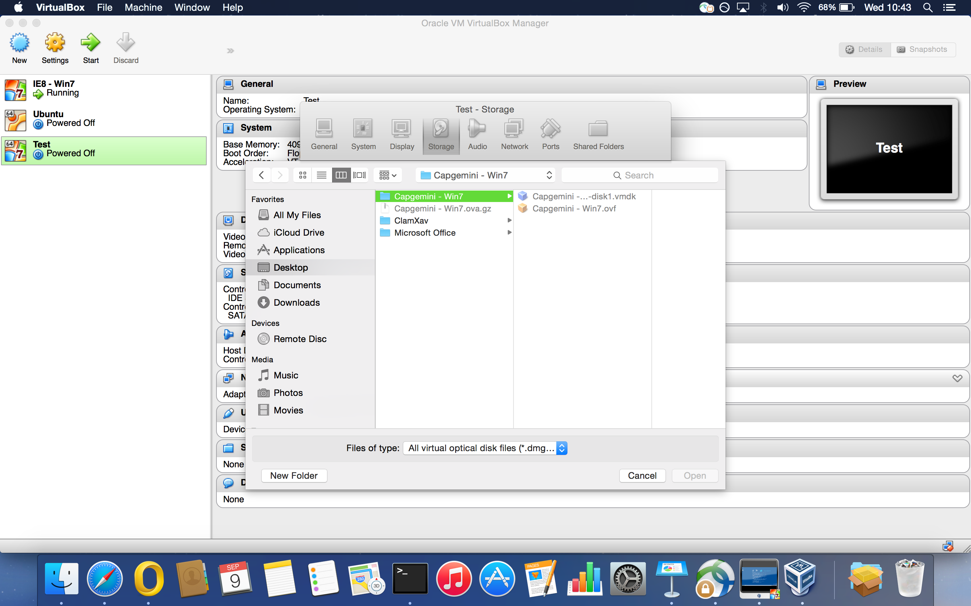

Slide 46
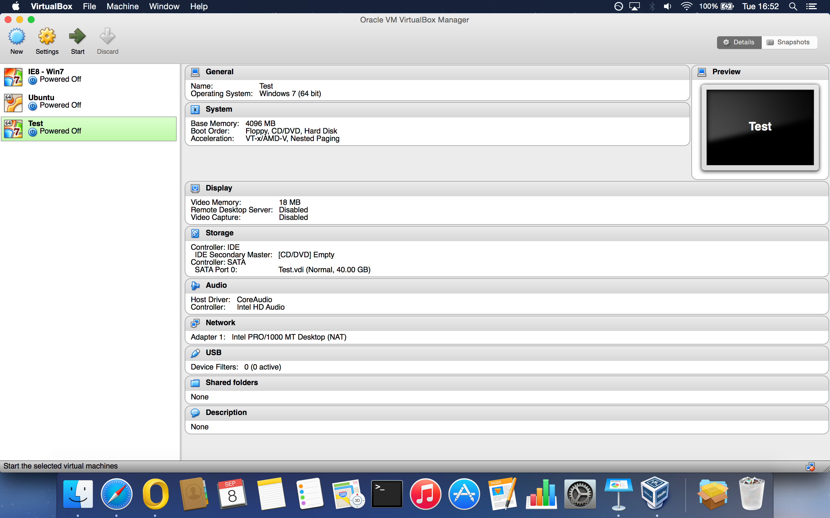

Slide 47
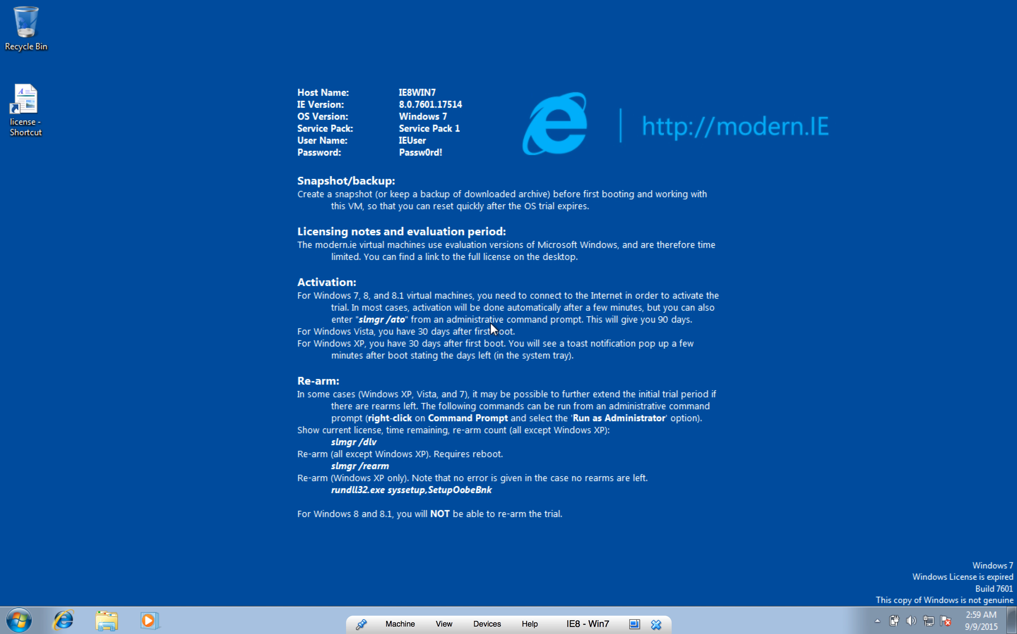

Slide 48
Thank you for listening
Do you have any questions?

